Slide 1
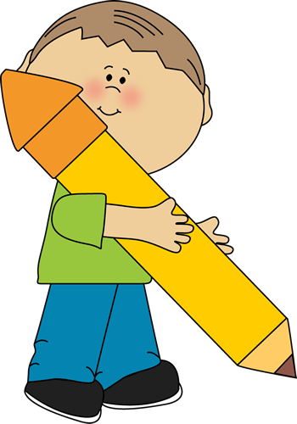
HOW TO HOLD A PENCIL

Slide 2
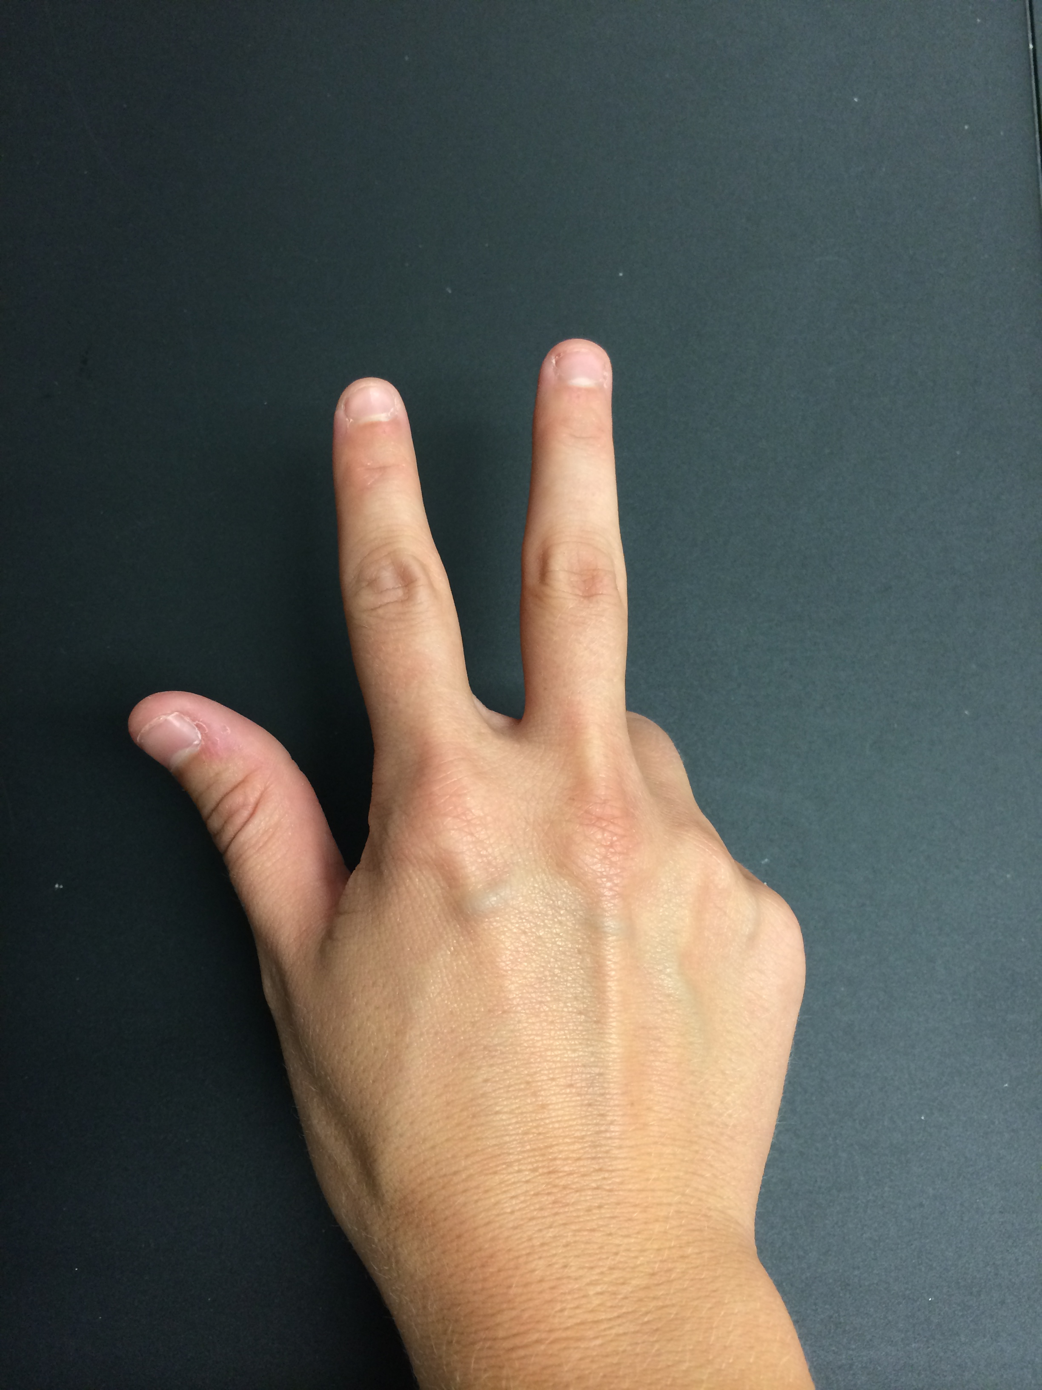
Stretch out your thumb, pointer and tall man fingers.
Tuck in Ring-man and Pinky.

Slide 3
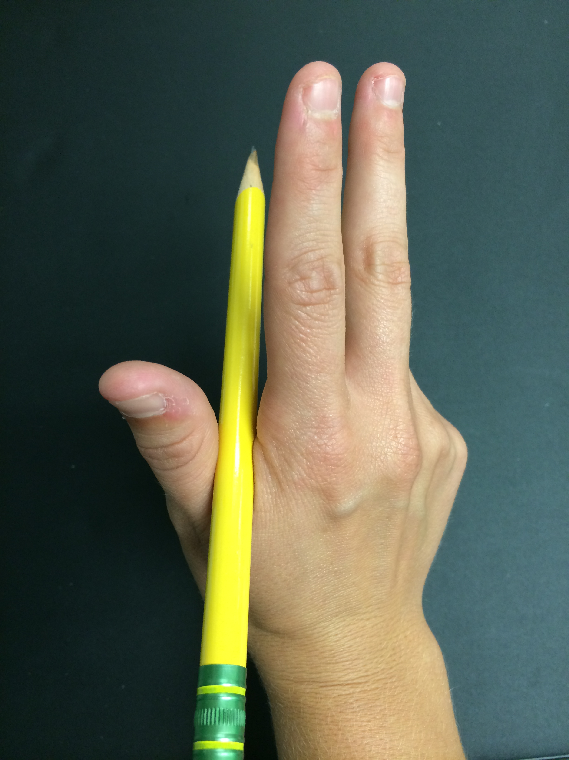
Rest your pencil on the pillow.

Slide 4
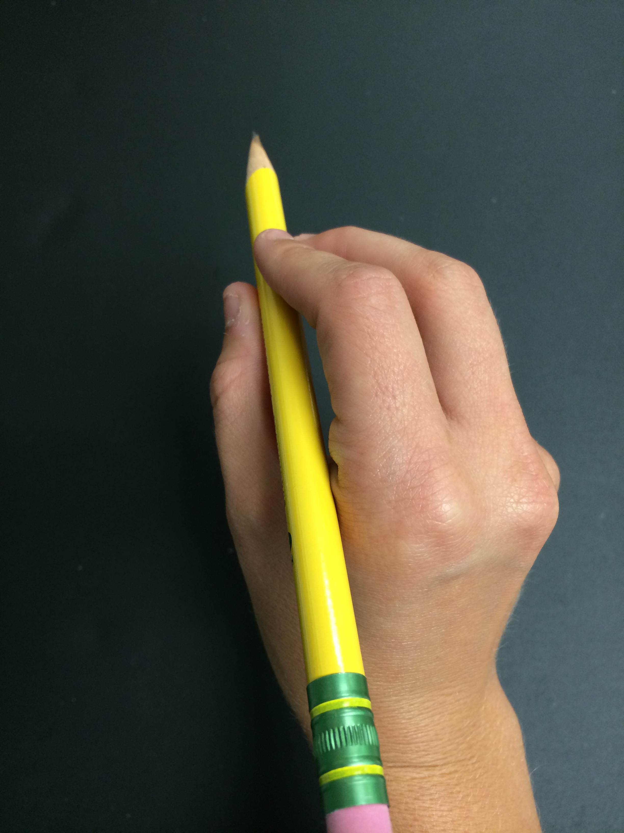

Pinch the pencil with your thumb, pointer and tall-man fingers like an alligator!

Slide 5
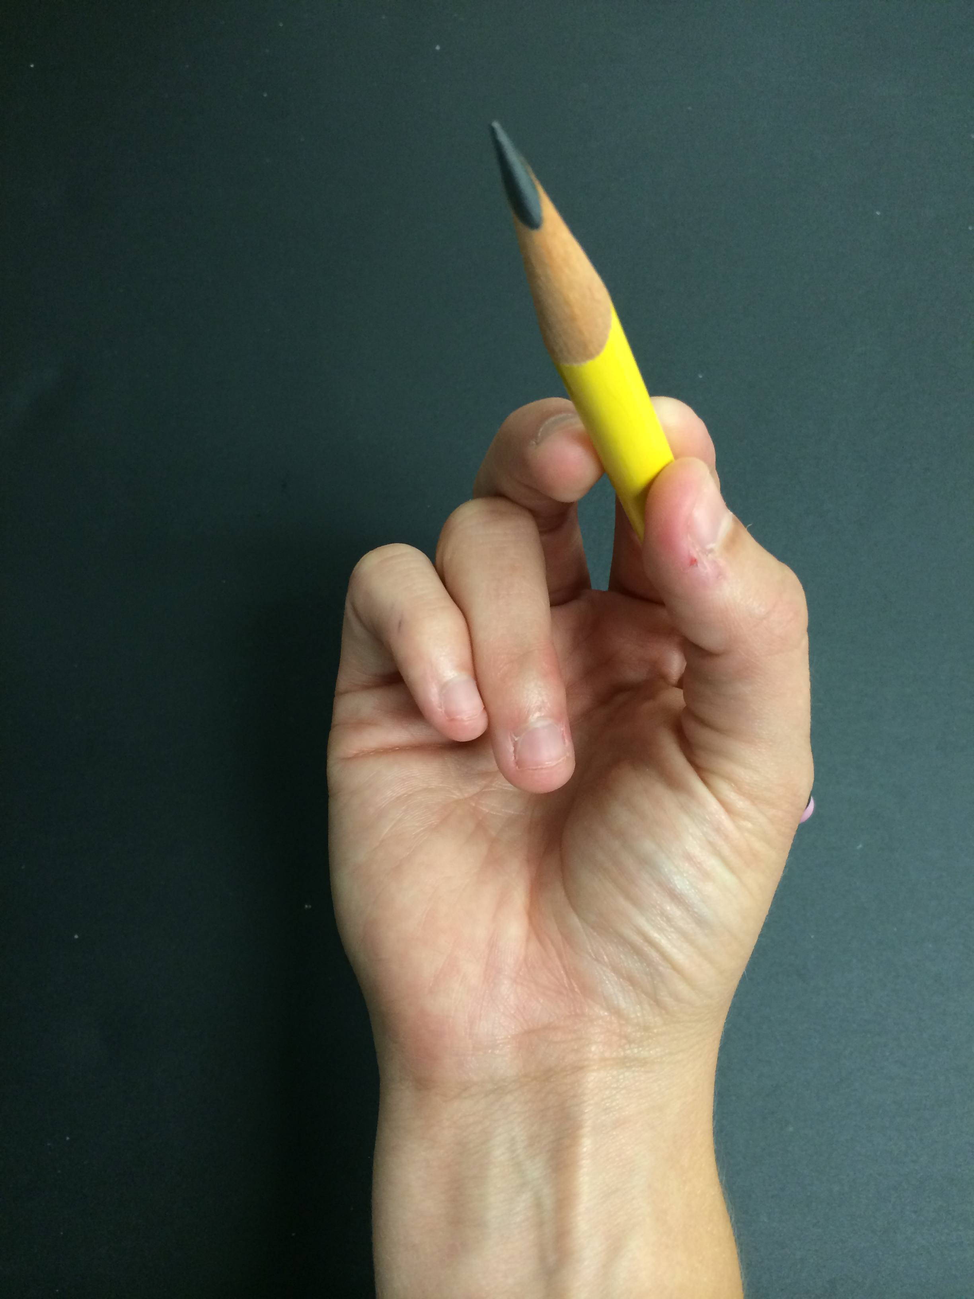
It should look like this!

Slide 6
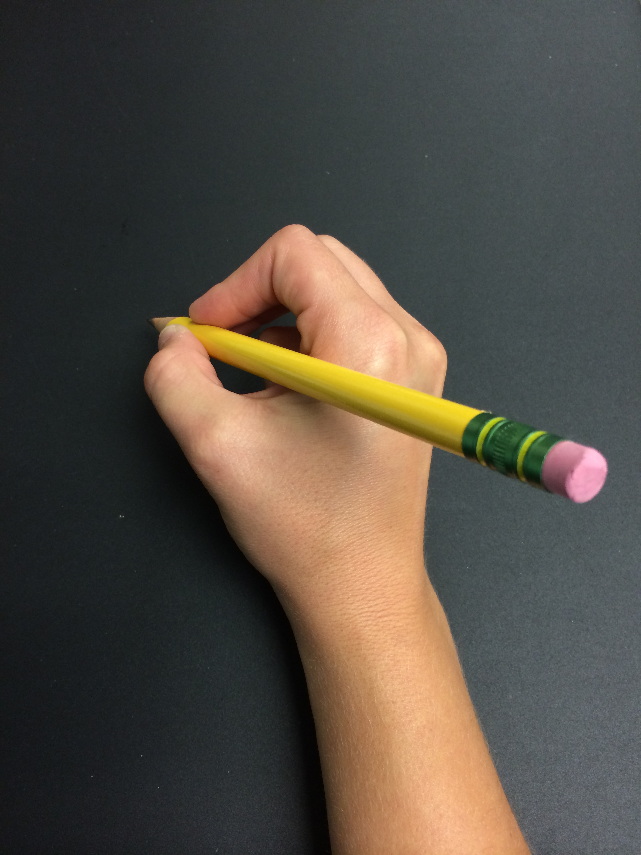
YOU DID IT!
GREAT JOB!!!

